Slide 1
Access Point Customer Adoption System
Students Details -
Ria Bhat
(IT- 4041- 2K16)
Darshita Aggarwal
(IT- 4019- 2K16)
Supervisor -
Dr. Rewa Sharma

Slide 2
Introduction Amazon customers use retail website to place their orders for getting it delivered to home address. Access Point like lockers solve the problem of doing unattended deliveries and where customers can and with their convenience use Access points to pickup or return their packages. Project is to increase the adoption rate of Access Point by targeting related customers who never heard or used of Access Point.

Slide 3
Need- In many cases we see that the customers who place order are neither available to attend their delivery nor their family members are. This increases the work for the delivery boy because he has to check for the user’s availability. This also increases the cost of delivery for the organisation. Our main aim is to target those working or busy customers who need to be introduced to this idea. It is clear then they have no experience of lockers. We will mail them with the introduction of it and a gift code which will strictly work only when he uses from his account and will become invalid once used. Now, a satisfied customer is the best advertisement for any organisation…. Work is done ! ☺

Slide 4
Motivation- We have experienced it many times. It is neither the fault of the delivery boy nor yours. He works according to his chart or as the packages he needs to deliver in least time possible. So he will try to cover the route accordingly but will not ask you when you are free. Neither will you be able to contact him that you are available for a specific time window.

Slide 5
Objective- Amazon Lockers let you pick up your package on your schedule, not the arcane and unknowable schedule that governs front door delivery. The process of having something delivered to a locker is just like having it delivered to a home. The only extra step is deciding which locker will be your package's destination.

Slide 6
Scope 1. Determine target customers. 2. Locate Access Points closer to their homes. 3.Marketing – Sending communications(via emails etc) to customers telling about orders Access Points near them. Sending coupons/gift codes if they place any order to Access Point. 4. Manage discount coupons/ gift codes etc which are configurable on geographical level and provide tools for marketing managers to onboard them. 5. Generate daily level reports on how many customers are using gift codes for ordering at Access Points and how utilization of Access Points is increasing.

Slide 7
Goals- 1. Access Point Management Services. 2. Coupon Code Management Services.

Slide 8
Working- This is an application which will be developed in web as well as android to help those customers which are not always available to receive their deliveries. Our main aim is to target those working or busy customers who need to be introduced to this idea. Once this is popular enough, we will stop its marketing. We will provide different Access Points at different locations each having more than one locker of varying size and capacity. User can either choose one locker according to his needs and use it. Or if placed an order using Amazon and choosed the mode of delivery as locker then we will do this work for him.

Slide 9
Working Continued- But for now the main problem is that the users are unaware. There are a number of users who place orders but due to their unavailability the delivery boy has to try more than once to complete his job. This increases the work for him and cost for company. So, we will simply choose those users who have a poor track record and have crossed a threshold of unattended deliveries. It is clear then they have no experience of lockers. We will mail them with the introduction of it and a gift code which will strictly work only when he uses from his account and will become invalid once used. Now, a satisfied customer is the best advertisement for any organisation…. Work is done ! ☺

Slide 10
List of tools to be used – DynamoDB MongoDB NodeJs HTML CSS Android Google map api rest api

Slide 11
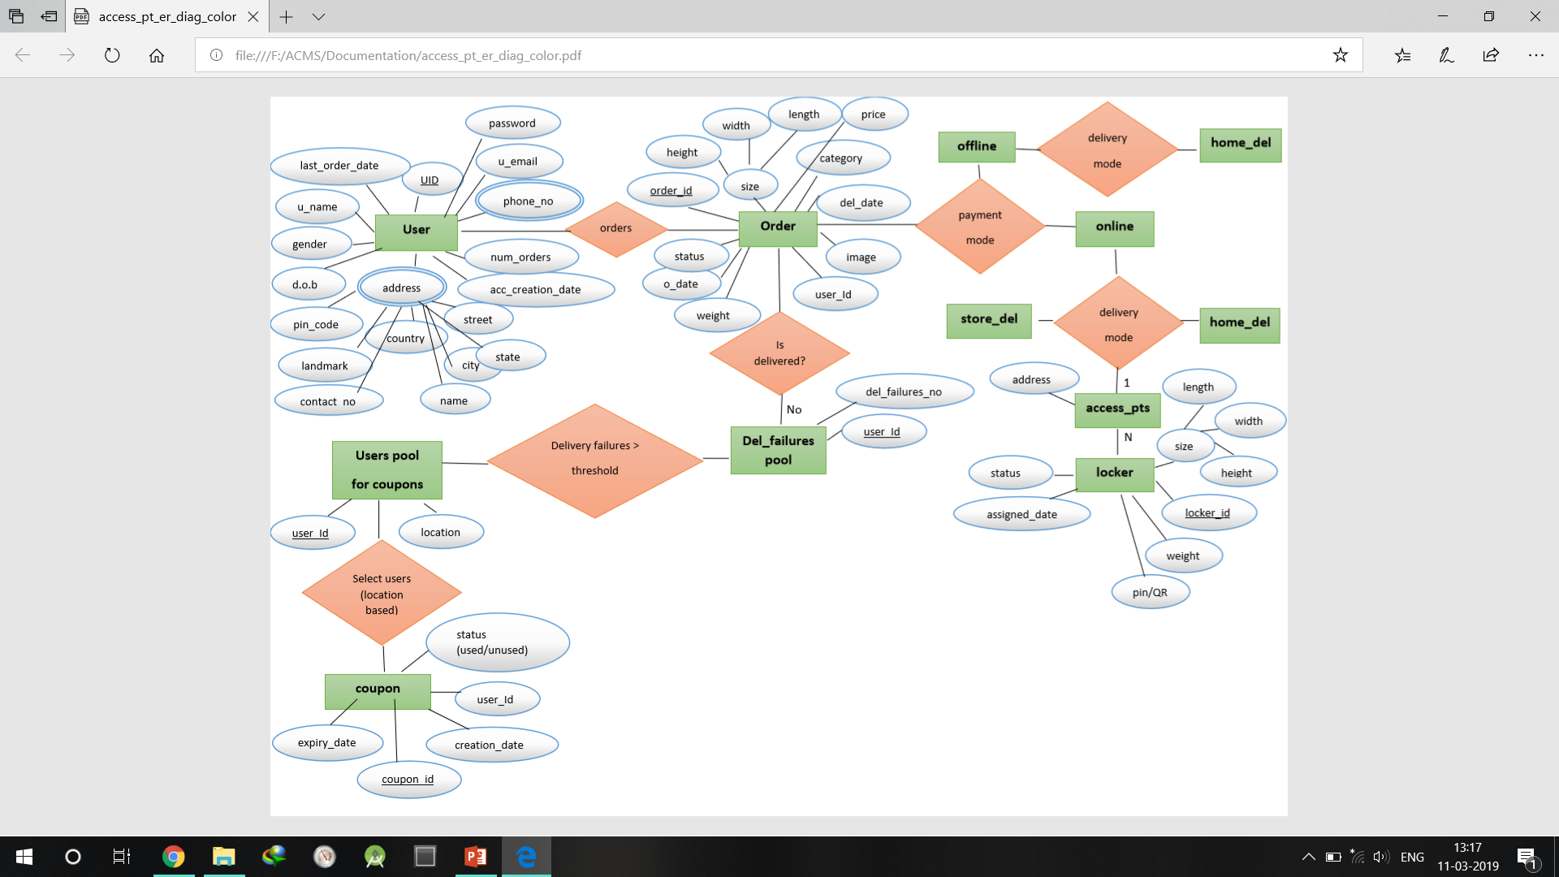
Progress- We have developed an ER diagram for showing the flow of project.

Slide 12
Progress Continued- Database- We have developed a database using mlab which contains user and locker schema. Locker- This schema contains the Geocode, dimensions and capacity for each locker in every Access Point User- This schema maintains the user details and number of unattended deliveries for each user.

Slide 13
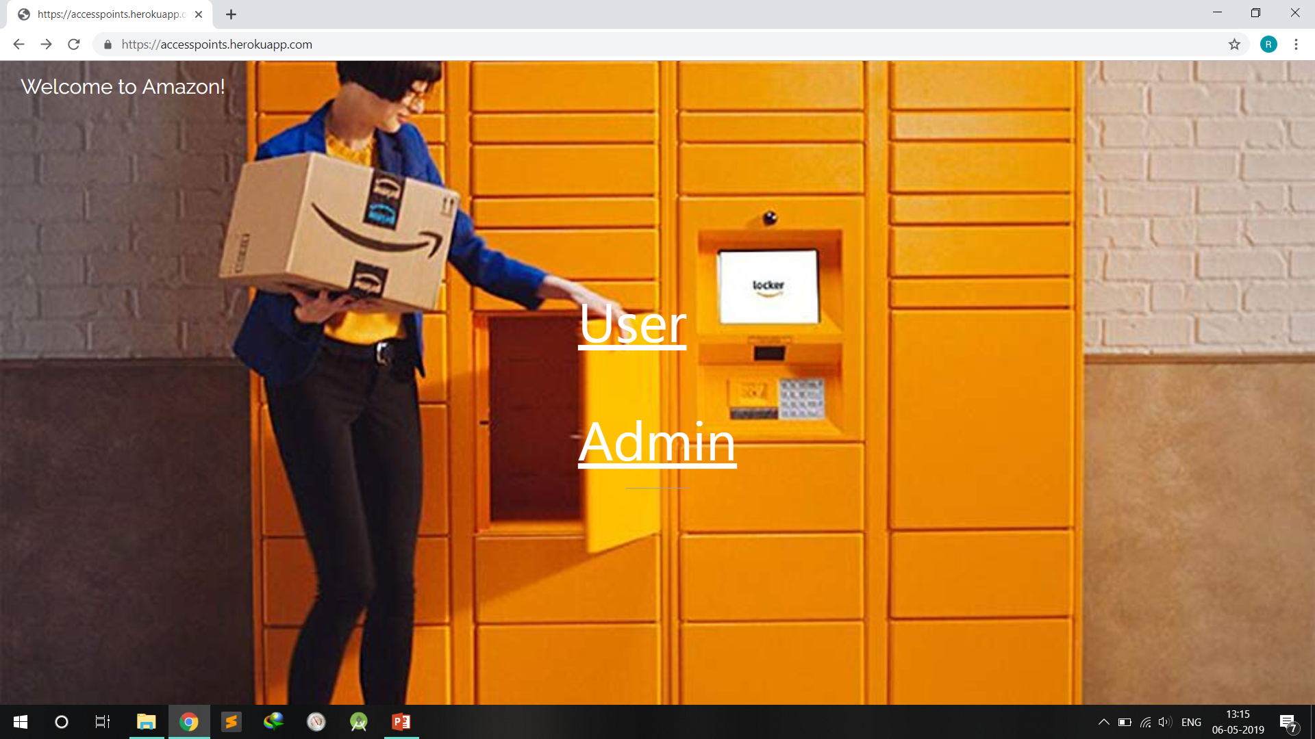
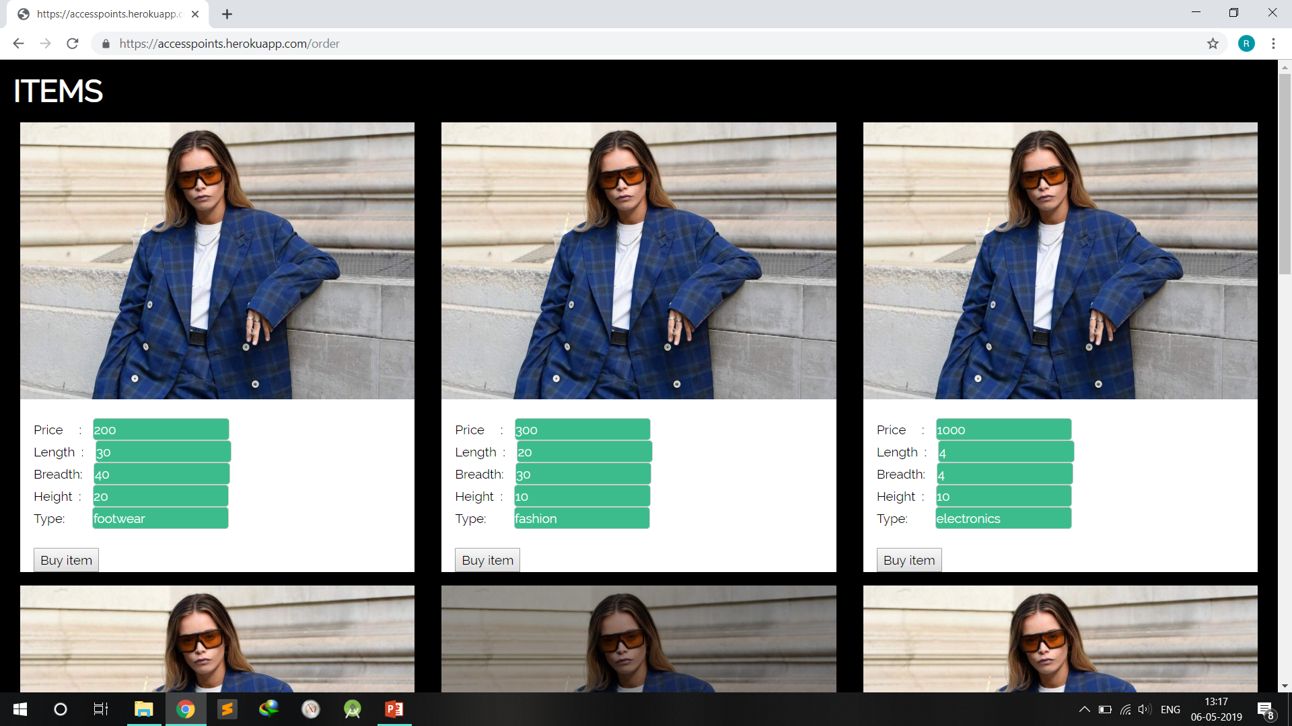
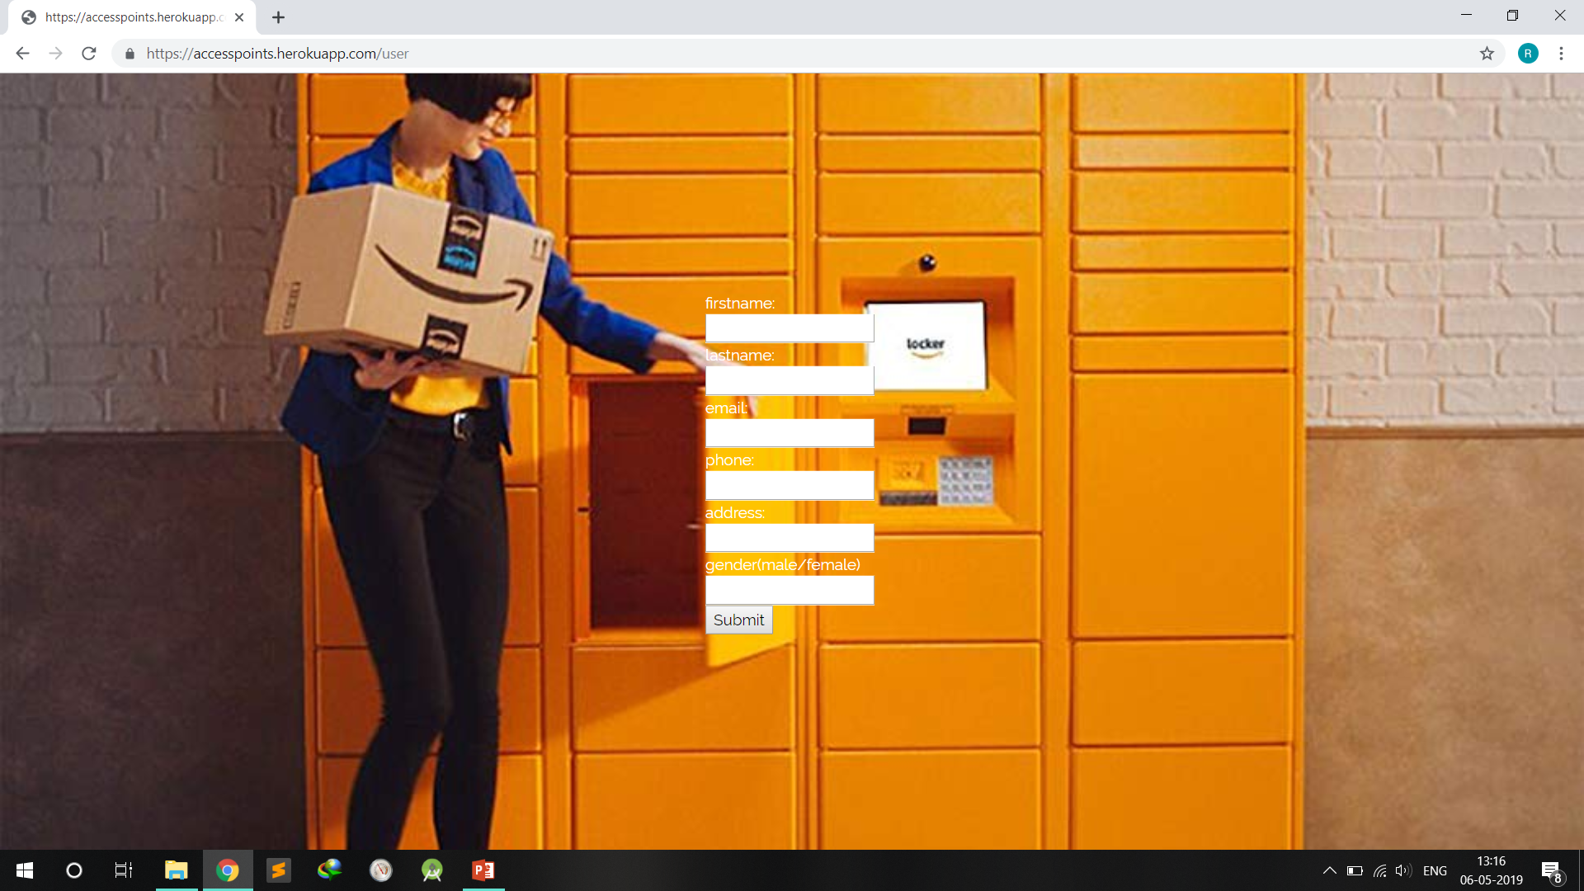


Slide 14
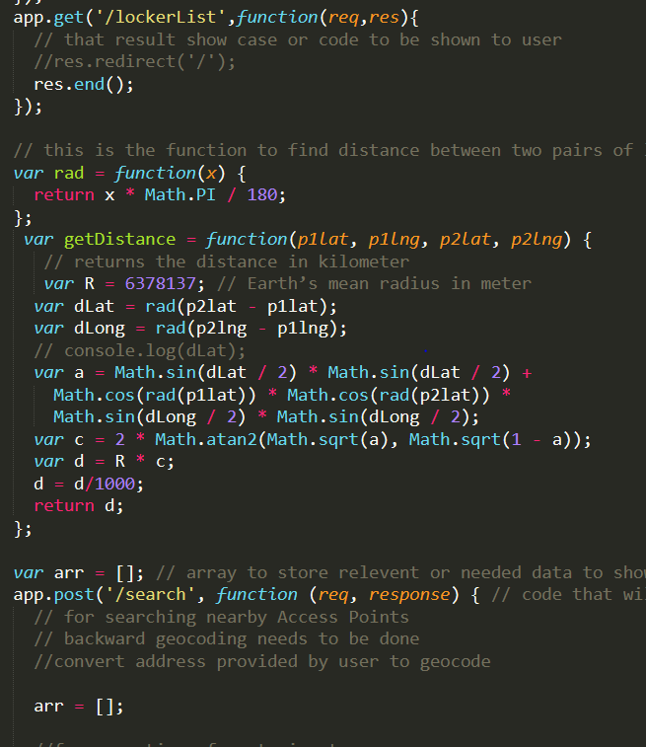
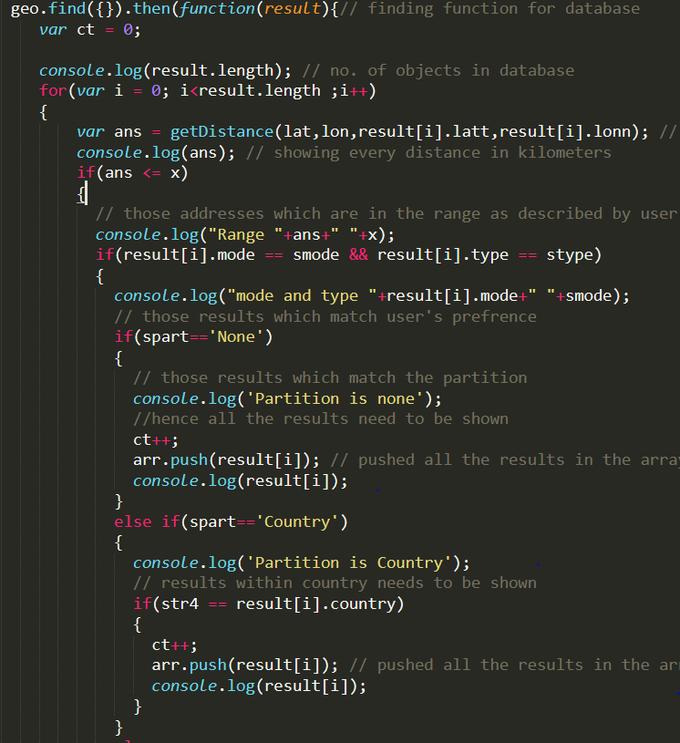

Slide 15
Thank you ☺

